Slide 1

World Bank Bias Analysis
By: Najahme Ridley

Slide 2
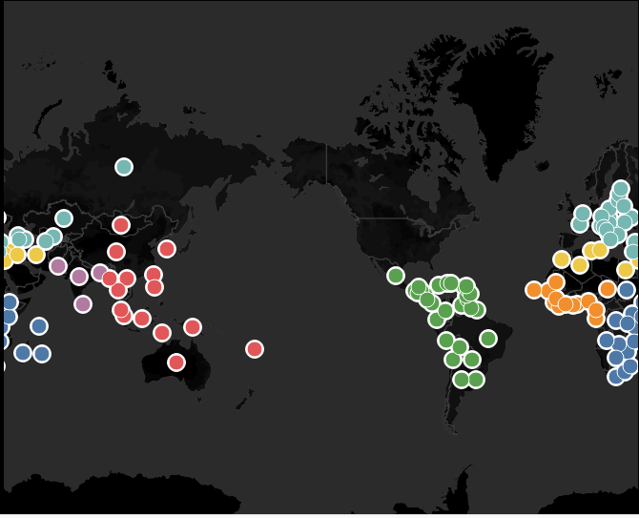
Countries that have received Funding from the world bank since Origin

Slide 3
About MY DATASET
My original dataset consisted of 8970 observations and 25 variables
After removing non-numerical data there were still 8848 complete observations and 9 Variables for analysis for my final analysis (not including the variable interest rate being analyzed)
My data consisted of World bank lending factors since 1947, the year of the program origin.
After removing incomplete data and NA’s: 8848 observations and 25 variables

Slide 4

Hypothesis:
Hypothesis: My hypothesis is that there would be bias in the lending practice. However, I was not sure how these biases would present.
Stakeholders: World Bank Loan Officials & Countries requiring Funding

Slide 5
Why this is Important
The World Bank lending programs assist developing countries by providing them with reasonable, low interest loans. Analyzing biases in lending practices is beneficial to explain the lack of development in countries.
Additionally, it would negate the goal of the organization if countries are not able to develop because they are crushed under the weight of loans they can not repay.
For stakeholders, it is important to see if there lending practices are hindering a timely repayment.

Slide 6
About My pre-Analysis process
To begin my analysis, I started with Random Forest. This data was character heavy, so it was important to remove any variables that could not be used in analysis. Character values that I consider important were converted to factors to be used in Random Forest.
Data split: 80 Train/ 20 Test
Seed:123
Characters: Region & Country converted to Factors for analysis.
Variables Removed:
Variables: Currency of commitment, last Disbursement Date, Undispersed Amount, Due to Third Party, Due to IBRD, Exchange Adjustments, Loans Held &, Date orientated Data.

Slide 7
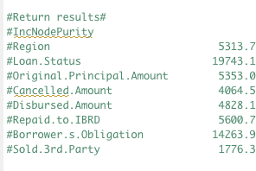
Random Forest Return:
#randomForest(formula = Interest.Rate ~ ., data = wb_train, Importance = TRUE)
#Type of random forest: regression
#Number of trees: 500
#No. of variables tried at each split: 8
#Mean of squared residuals: 0.8742744
#% Var explained: 92.78
Notes:
I used this model to determine which variables would be most important for my model.

Slide 8
Exploration: Multi-Linear Regression
Results:
Variables included in the model: Region, Loan Status, Interest Rate, Original Principal Amount, Cancelled Amount, Disbursed Amount, Repaid to IBRD, Borrowers Obligation & Sold to 3rd Party.
Residual Standard Error: 2.505 on 8824 Degrees of Freedom
Multiple R-squared/ Adjusted R-squared 0.4828/0.4815
P-Value:2.2 e -16
Notes:
There is not a significant difference between the mult. R-squared and adjusted r-squared. Therefore, it is to reasonable believed the model was appropriately fit.
P-values shows the variables chosen were significant

Slide 9
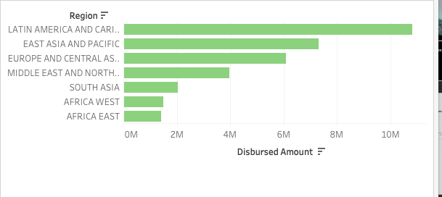

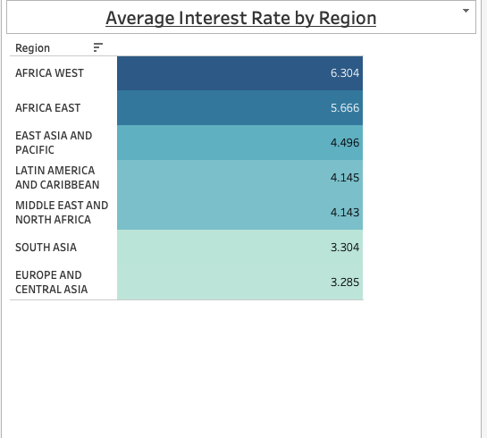
Discovery: Using linear regression, I discovered the most consistent variable the attributed to higher Interest rates were Regional Biases. Although Latin America received the most funding, Their interest rate was within the median.

Slide 10
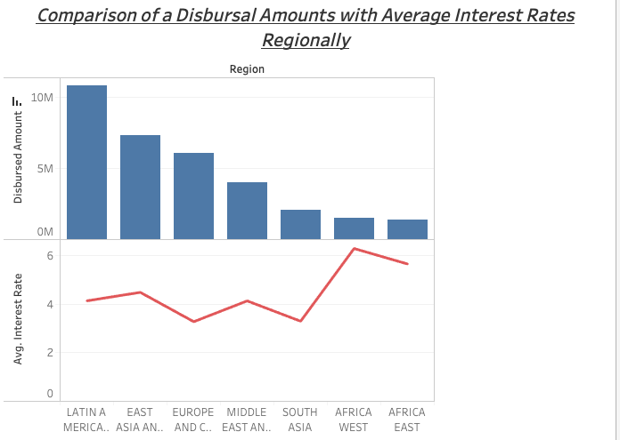
Dual Visuals Showing
Notes:
As you can see Africa East and West have the higher interest rates out of the

Slide 11
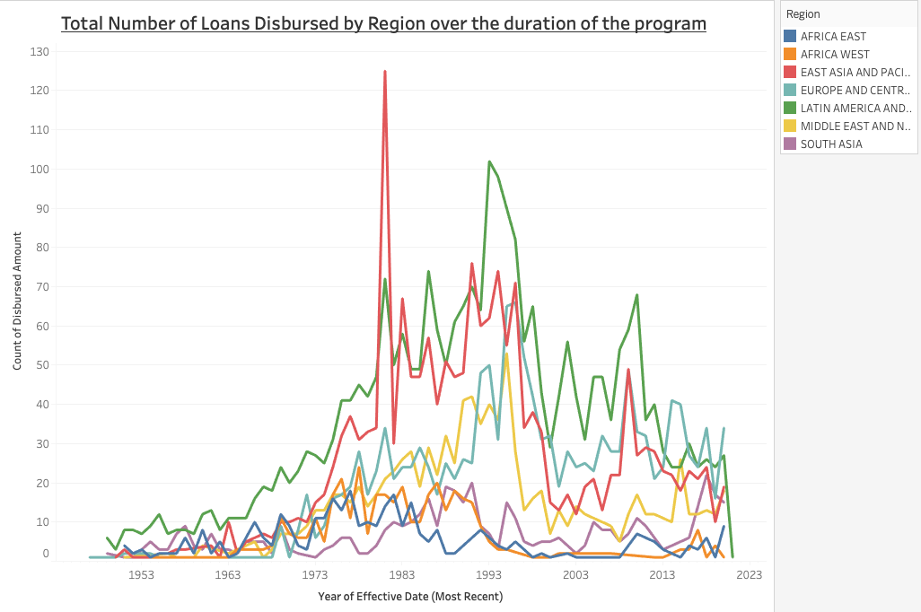
Further steps and Future analysis
Due to storage issues, I was not able to run code to gather my MSE for all models used other than Random Forest. I would like to collect MSE’s for all my models in future analysis.
In alignment with my discovery of regional biases I would like to further analyze repayment time for lenders that received higher interest loans in contrast to lower interest borrowers
If I were to do additional analysis, I would like to further analyze the poverty ranking of the countries and regions in this analysis. I think if such a metric exist it would be a reasonable variable in explaining why other countries that receive less funding are historically charged higher interest rates- what is the primary source of the countries income?

Slide 12
Conclusion & Recommendations:
There is negative correlation between borrower’s obligate repayment and interest rate and Disbursed amount and interest rate. It appears, higher loans are also a contribution to lower interest rates.
My recommendation would include requiring a guarantor for “high-risk” countries they would act as an investor. This guarantor would be required to pay or/front a portion of the loan as down-payment perhaps, 20% and this would qualify the borrowing country for lower interest loans.
The incentive would be stock in a portion of the country’s resources.
Researching the viability of this request is imperative.

